Slide 1


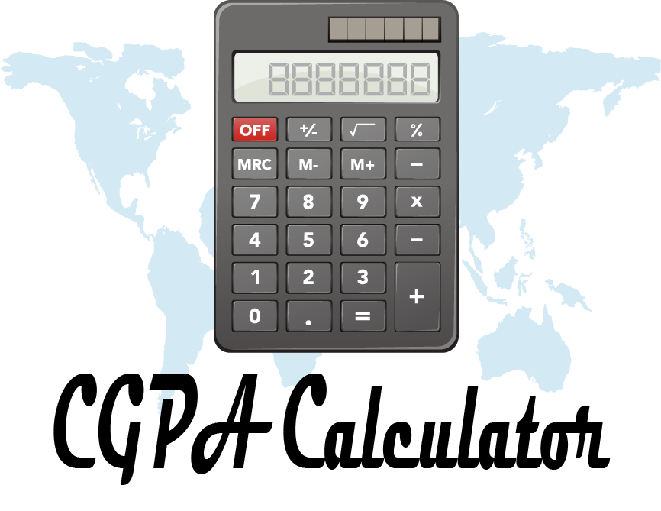
Enhancing Digital Government and Economy (EDGE)

Slide 2
Project Author: Md Zakaria Hossain Batch: 32 Course Title: Introduction to Programming with Python ID: B03225
Author Details:
Name : Md. Zakaria Hossain
Department : Physics
University : Bangabandhu Sheikh Mujibur Rahman Science and Technology University, Gopalganj ID:19PHY008

Slide 3
Introduction
The CGPA (Cumulative Grade Point Average) calculator is a software tool designed to assist students and educational institutions in calculating and managing academic performance. This tool aims to provide a comprehensive solution for calculating CGPA, handling multiple subjects and semesters, and generating detailed reports in various formats such as Excel, PDF, JPG, and PNG. The project incorporates a user-friendly interface for data input and supports generating visual and tabular reports.

Slide 4
Features
Course Data Entry: The tool allows users to input subject details, including course credits and obtained marks.
Grade Calculation: It automatically determines the grade point based on the marks entered using predefined criteria.
CGPA Calculation: It calculates CGPA by taking the weighted average of the grade points and course credits.
Report Generation:
Excel Format: Exports the result to an Excel file.
PDF Format: Converts the tabular data into a PDF report.
JPG/PNG Image Formats: Saves the results as images for easy sharing.
File Management: Automatically handles file naming to prevent overwriting, offering alternatives if files with the same name exist.

Slide 5
Implementation
The CGPA calculator is implemented using Python, with support from several libraries and modules:
Python Libraries:
Pandas: For data handling and manipulation.
OpenPyXL: To read and write Excel files.
Matplotlib: For creating visualizations and tables.
OS: For file and path operations, such as checking if a file already exists.
Tabulate (if applicable): If you're using tabular formats for better data presentation in terminal output.
PDF Creation Libraries:
Custom libraries like pdf_maker (for converting data frames to PDF).
Image Conversion Libraries:
Custom libraries like jpg_maker and png_maker (for converting data to JPG and PNG formats).

Slide 6
Implementation:
Modular Code: The project is divided into several files, each responsible for different functionalities:
others.py: Contains the core functions for CGPA calculation, data input, and saving results in different formats.
dphysics.py: A specialized module for handling data related to a physics course, focusing on semester-based evaluation.
pdf_maker.py: Handles converting data frames into PDF format.
jpg_maker.py: Converts tabular data to JPG images.
png_maker.py: Converts tabular data to PNG images.

Slide 7
User Interaction:
Prompts users for the number of courses, credits, and obtained marks.
Offers options to save the result in multiple formats.
Ensures user-friendly error handling with prompts for correct input if mistakes are made.

Slide 8
Reports
The software is capable of generating detailed reports in multiple formats:
Excel Report:
Presents a structured tabular format of course data, including subject names, credits, marks, grade points, and the overall CGPA.
Useful for in-depth data analysis.
PDF Report:
Provides a compact, portable report suitable for sharing or printing.
Maintains the table format of course data for easy readability.
Image Reports (JPG & PNG):
Saves the report as an image, making it accessible on any device without additional software.
Ideal for quick sharing via social media or messaging platforms.

Slide 9
Conclusion
The CGPA calculator project successfully provides a flexible and versatile solution for students and educational institutions. With its modular implementation, user-friendly interface, and capability to generate reports in multiple formats, it meets the diverse needs of academic performance analysis. This tool facilitates accurate CGPA calculation and efficient report management, ensuring a seamless experience for users.

